Slide 1
COMPARISON BETWEEN SINGLE AND MULTI OBJECTIVE GENETIC ALGORITHM APPROACH FOR OPTIMAL STOCK PORTFOLIO SELECTION
Authors: | Cvörnjek Nejc
 | Brezocnik Miran
 | Jagric Timotej
 | Papa Gregor

Slide 2
INTRODUCTION
Finding a solution for an investment process with which we can have influence on a computation time
Master thesis based on financial modelling with nature inspired algorithms
Stock price predictions with Neural Network
Portfolio optimization with GA, NSGA-II

Slide 3
PROBLEM PRESENTATION
Portfolio is a basket of multiple financial instruments desired to achieve diversification
Harry Markowitz in 1952
M – V model
Two parameters ${E(r}_{p})$ or ($μ_{p})$ and $σ_{p}^{2}$

Slide 4
MODEL PRESENTATION
Portfolio‘s expected return
$$E_{(r_{p})}=\sum_{i=1}^{n}{E_{(r_{i})}∗w_{i}}$$
Portfolio‘s risk
$$σ_{p}^{2}=\sum_{i=1}^{n}{\sum_{j=1}^{n}{σ_{ij}∗w_{i}∗w_{j}}}$$
Model constraints
$$0≤ w_{i}≤1$$
And
$$\sum_{i=1}^{n}{w_{i}=1}$$
where i,j = 1, 2,... N.

Slide 5
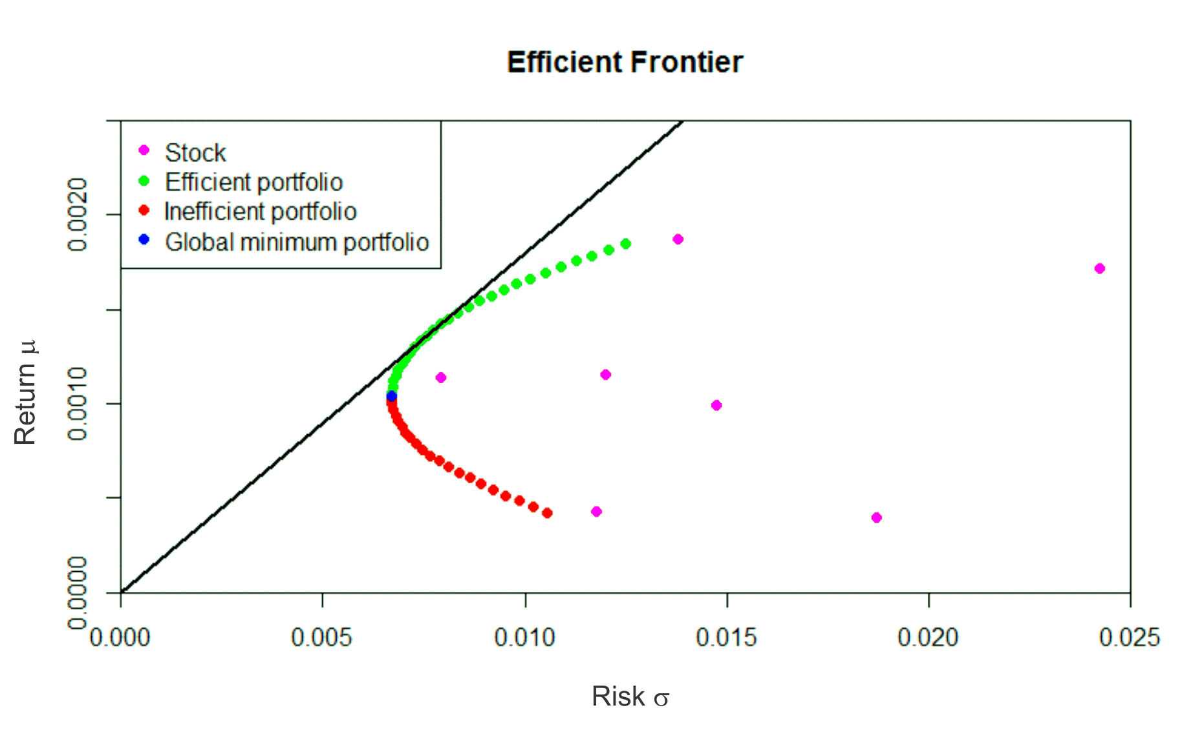
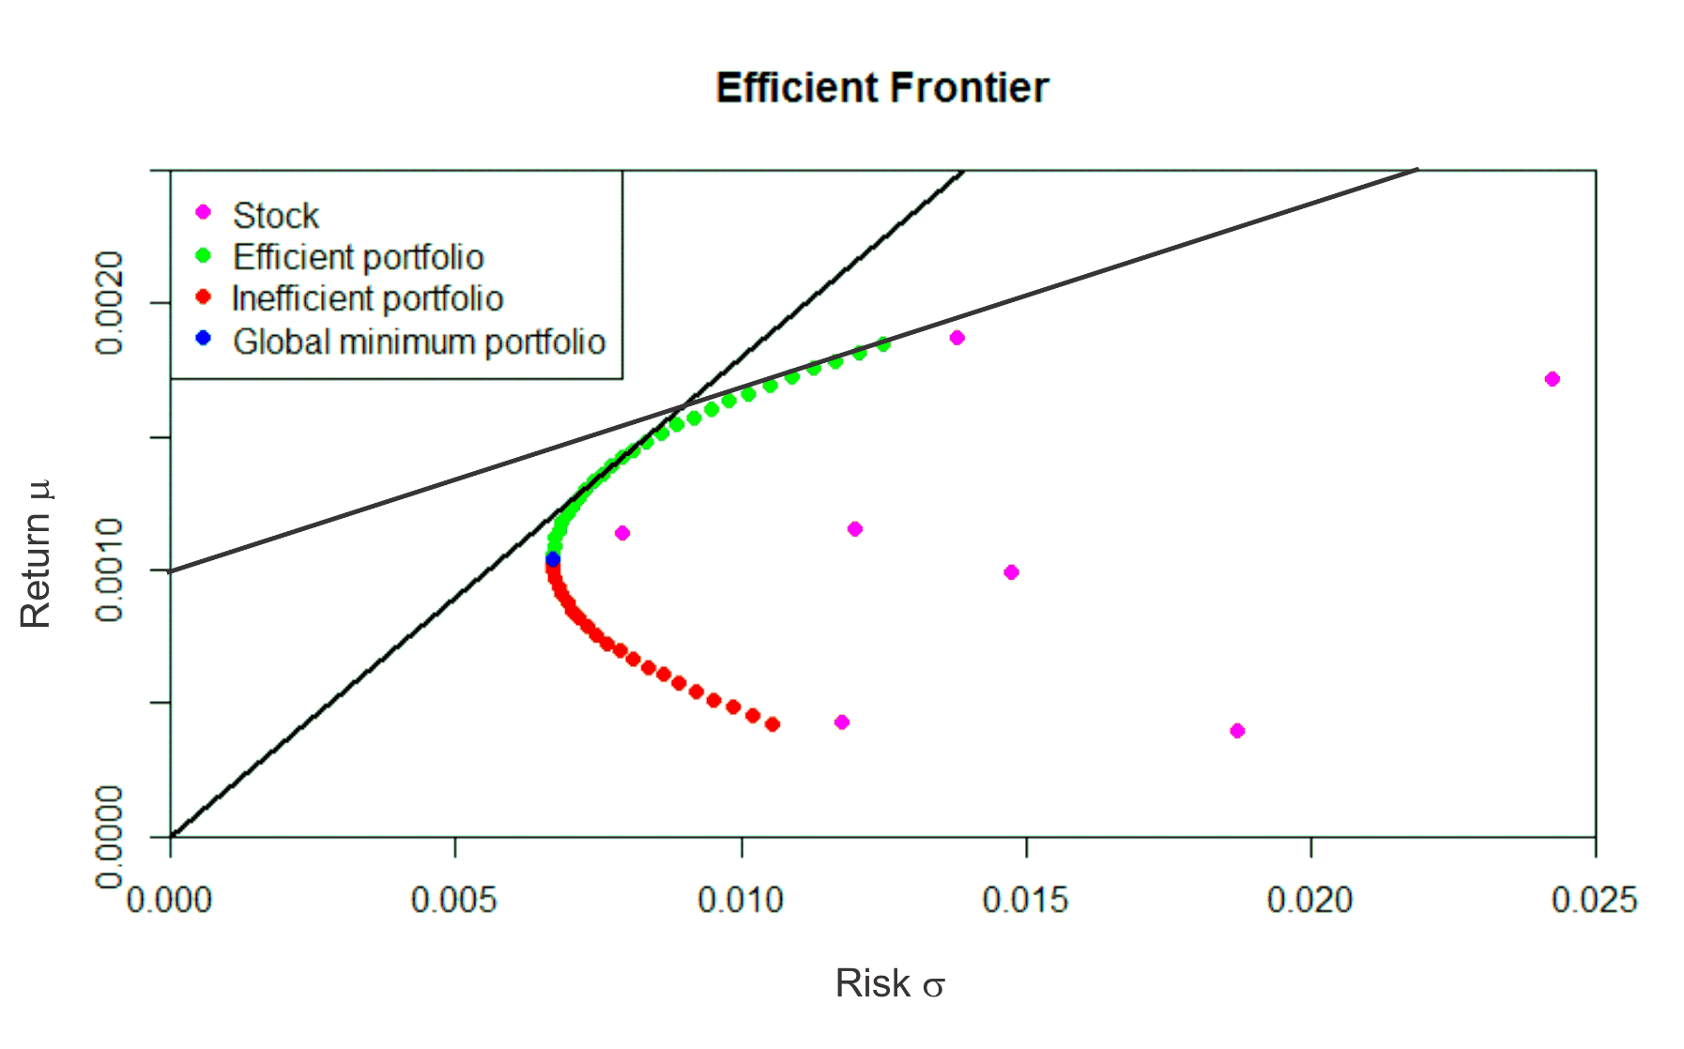
GRAPHICAL PRESENTATION OF M-V MODEL

Slide 6
Y. Xia, B. Liu, S. Wang, K.K. Lai: A model for portfolio selection with order of expected returns
Adopted weighted average method to calculate expected return
They include three parameters into equation
Arithmetic mean
Changes in tendency of return
Forecasted return based on financial report and individual experience
Fitness function was
$$maximise \left(1−λ\right)∗\sum_{i=1}^{n}{E\left(r_{i}\right)∗w_{i}−λ\sum_{i=1}^{n}{\sum_{j=1}^{n}{σ_{ij}w_{i}w_{j}}}}$$
You need to be an expert to forecast stock return with financial report.

Slide 7
C-M. Lin, M. Gen: An Effective Decision-Based Genetic Algorithm Approach to Multiobjective Portfolio Optimization Problem
They proposed a method where portfolio is formed based on yield of return
Fitness function was
$$f_{(x)}=\frac{f_{(return)}}{f_{(risk)}}=\frac{\sum_{i=0}^{n}{E\left(r_{i}\right)∗w_{i}}}{\sum_{i=1}^{n}{\sum_{j=1}^{n}{σ_{ij}w_{i}w_{j}}}}$$
Fitness function is very similar to Sharpe ratio formula
$$s= \frac{r_{p − r_{rf}}}{\sqrt{σ_{p}^{2}}}$$

Slide 8
S.K.Mishra, G. Panda, S. Meher, R. Majhi, M. Singh. Portfolio management assessment by four multiobjective optimization algorithm
In research authors compare four multi objective genetic algorithms
Performance was measured by S, Δ and C metrics
C metrics
Metrics | PESA | PAES | APAES | NSGA-II
S | 0.000404236 | 0.000082361 | 0.0000057372 | 0.000000574
Δ | 0.892482853 | 0.812181833 | 0.7862596192 | 0.5967844252
 | PESA | PAES | APAES | NSGA-II
PESA | — | 0.0000 | 0.0000 | 0.0000
PAES | 0.85222 | — | 0.3644 | 0.1562
APAES | 0.95990 | 0.2731 | — | 0.2653
NSGA-II | 0.96627 | 0.80321 | 0.37534 | —

Slide 9
S.K. Mishra, G. Panda, S. Meher, S.S. Sakhu: Optimal Weighting of Assets using a Multi-objective Evolutionary Algorithm
They compare three multi objective genetic algorithms
Performance was measured by S, Δ and C metrics
C metrics
 | PESA | SPEA2 | NSGA-II
S | 0.000304616 | 0.0000067874 | 0.000000574
Δ | 0.865412859 | 0.8337976192 | 0.5967844252
 | PESA | NSGA-II | SPEA2
PESA | — | 0.0000 | 0.0000
NSGA-II | 0.95790 | — | 0.2566
SPEA2 | 0.94627 | 0.08534 | —

Slide 10
PROBLEM
We randomly choose twenty stocks among different branges from S&P500 index.
We construct three sizes of portfolio. Portfolios have sizes of 5, 10 and 20 stocks.
Time period was from 01.01.2013 to 01.01.2014.
Stocks
CAD | AA | GS | PFE
TIF | CVX | JEC | TAP
AXP | KO | KSU | PM
NOC | F | MCS | GPS
FRX | GOOG | NVDA | MHK

Slide 11
RESULTS
Parameters | GA | NSGA-II
Population size | 50 | 50
Natural selection | 0.05 | /
Crossover rate | 0.9 | 0.9
Mutation size | 0.2 | 0.2
Tournament size | 2 | 2

Slide 12
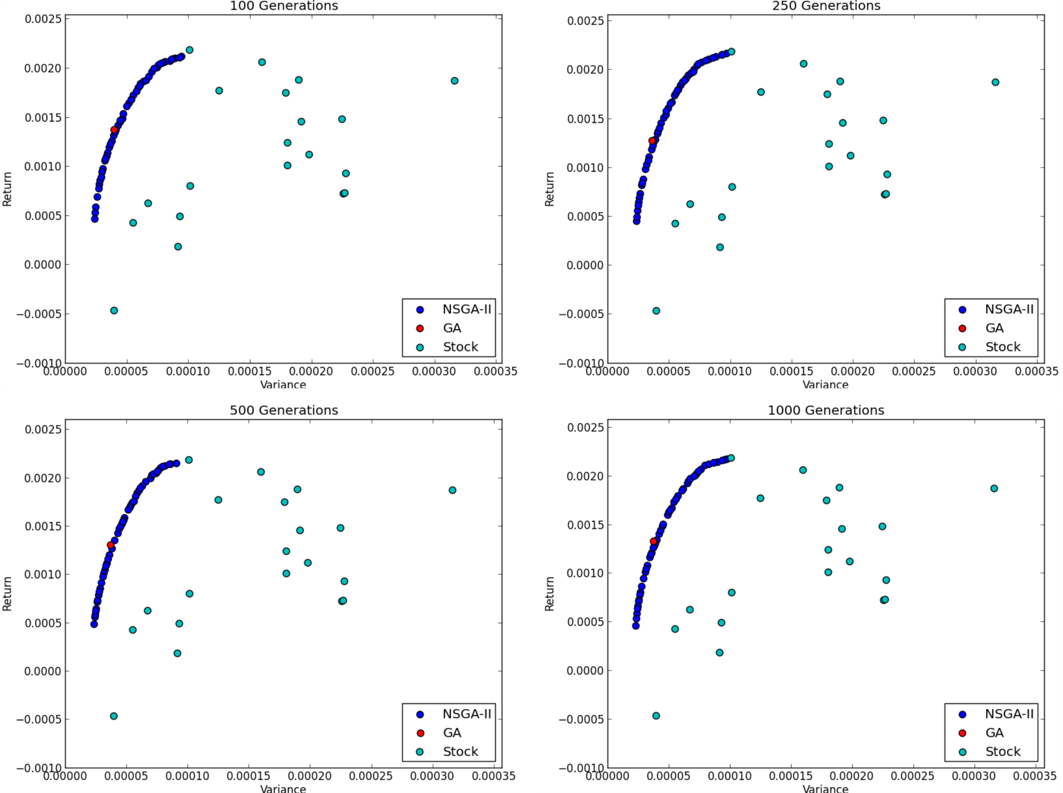
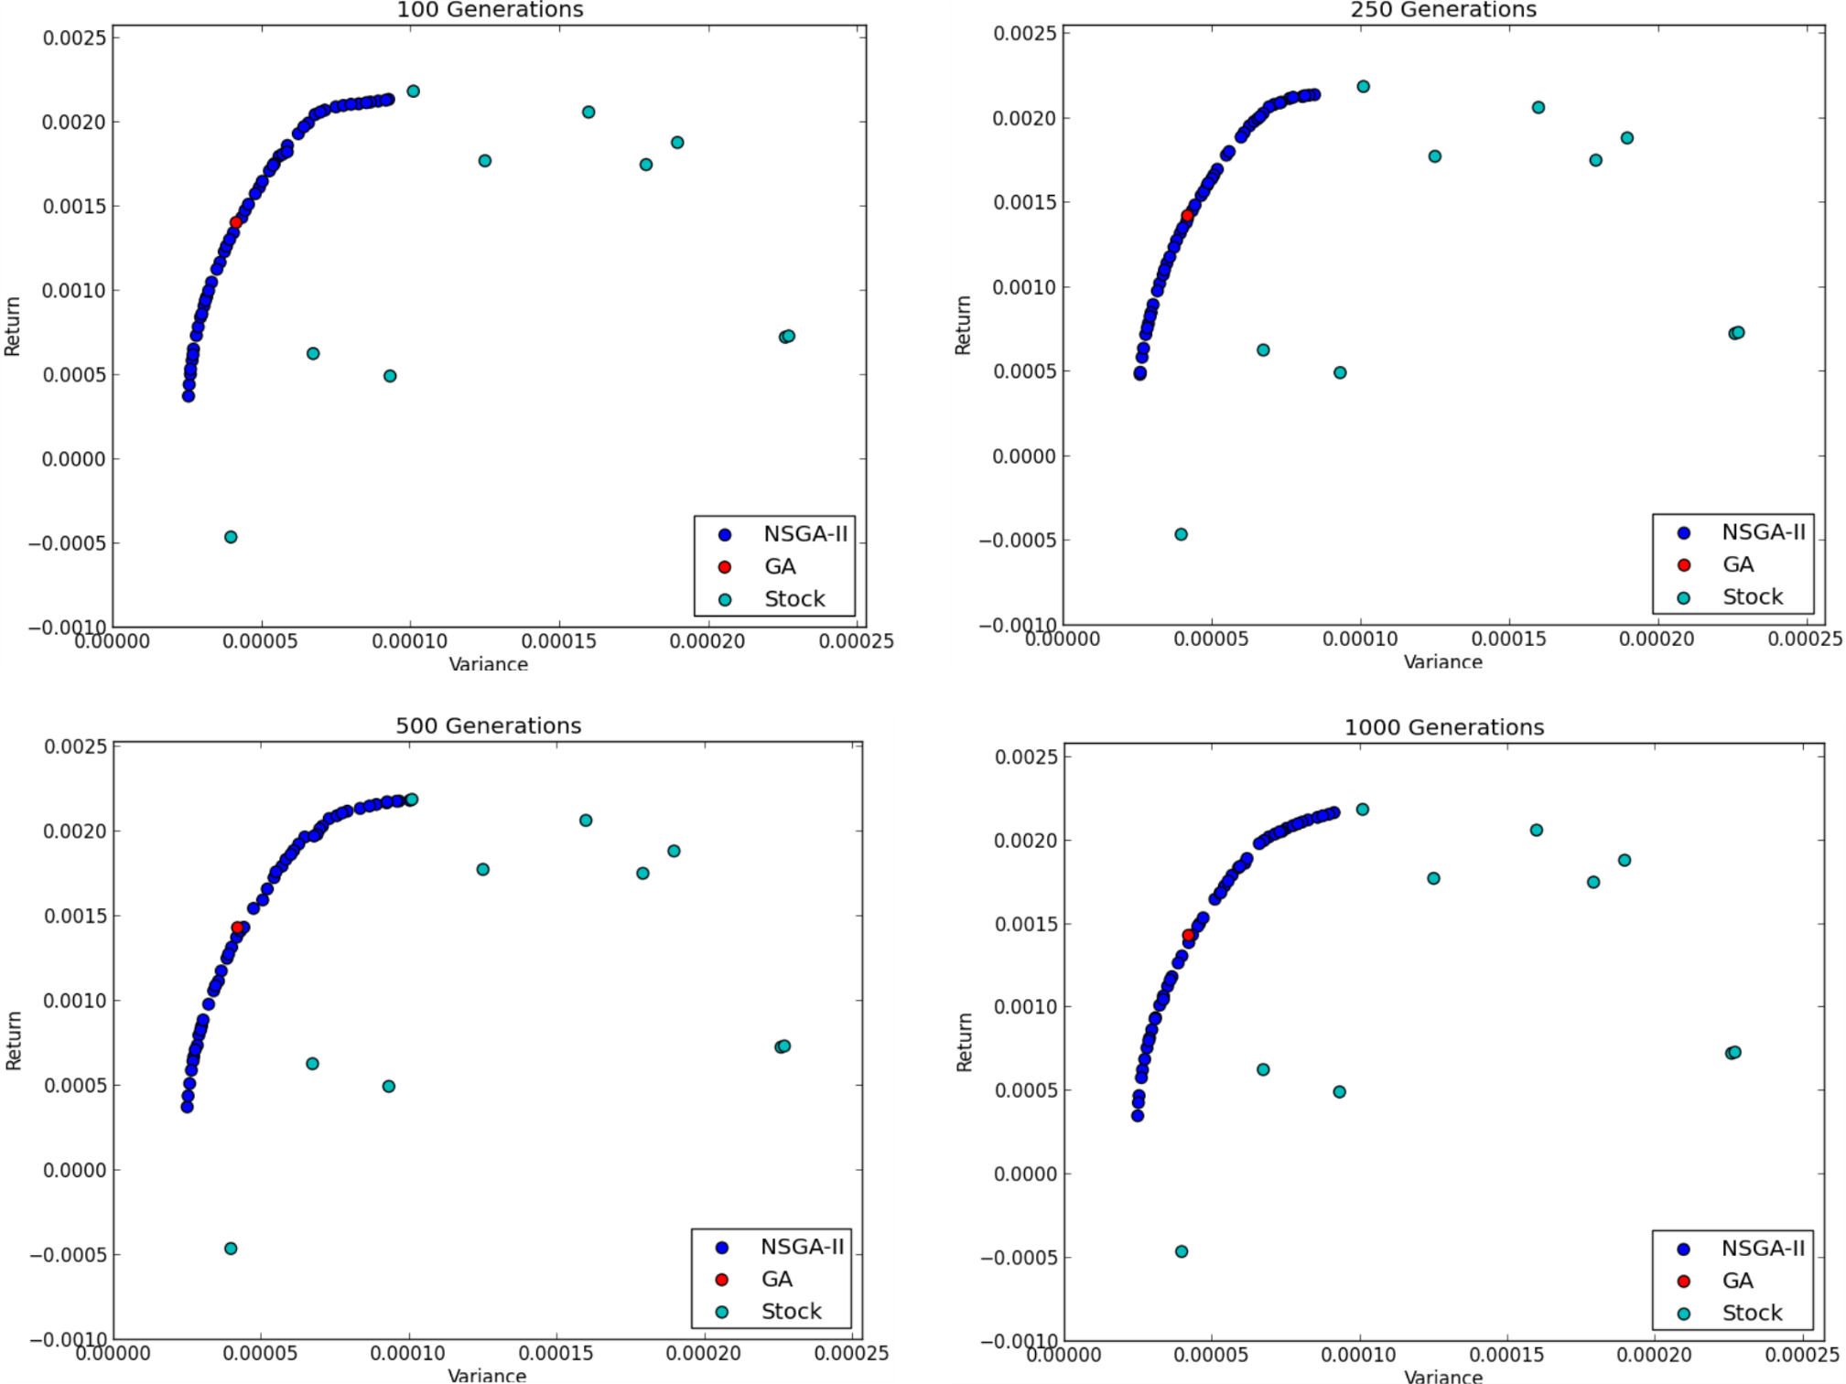

Slide 13
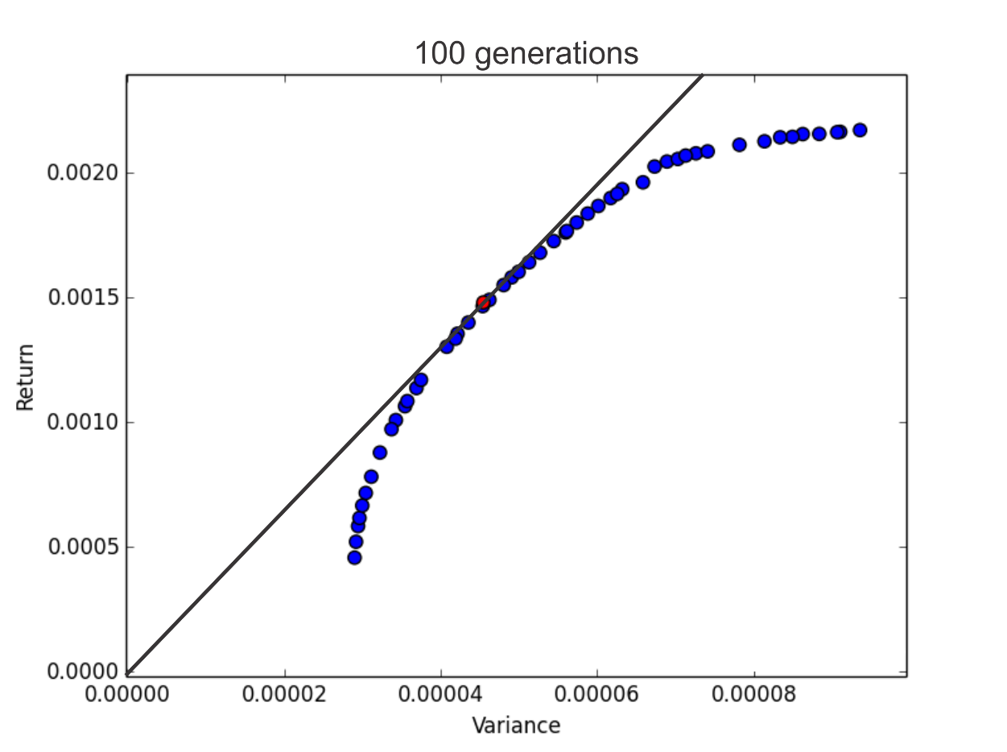

Slide 14
In global minimum portfolio a weight of CAD asset is 65%
Stock | Percentage | Return | Variance
CAD | 22.66 | -0.0004695423 | 0.000039831697
TIF | 11.92 | 0.0018764769 | 0.00018975974
AXP | 10.76 | 0.0017677318 | 0.000125013218
NOC | 38.69 | 0.0021811832 | 0.000101090825
FRX | 15.97 | 0.0020571237 | 0.00015994853
 | Σ=100

Slide 15
Correlation in 2006

Slide 16
Correlation in 2009

Slide 17
COMPUTATIONAL TIMES
Simple GA
 | 5 stocks | 10 stocks | 20 stocks
100 generations | 0,62 | 0,7 | 0,83
250 generations | 1,55 | 1,78 | 2,02
500 generations | 3,25 | 3,43 | 4,04
1000 generations | 6,42 | 7,06 | 8,06
NSGA-II
 | 5 stocks | 10 stocks | 20 stocks
100 generations | 83,19 | 83,8 | 84,67
250 generations | 206,16 | 209,08 | 210,33
500 generations | 414,24 | 418,86 | 423,97
1000 generations | 827,01 | 841,79 | 857,36

Slide 18
CONCLUSION
None of techniques overperformed in finding a solution
In M – V model stocks with a lower variance are preffered
Simple GA is significantly faster than NSGA-II
Simple GA is more efficient than NSGA-II

