Slide 1
PARALLEL CUDA IMPLEMENTATION OF THE DESIRABILITY BASED SCALARIZATION APPROACH FOR MULTIOBJECTIVE OPTIMIZATION PROBLEMS
Eren AKÇA
HAVELSAN A.S., Ankara, Turkey
eren.akca@havelsan.com.tr

Slide 2
Outline
Motivation
The Main Idea Beneath the Scalarization and Weighted Sum Approach
Desirability Function- Based Scalarization
Parallel CUDA Implementation of the Desirability Function- Based Scalarization
Lessons Learned
Future Work
Acknowledgement
References

Slide 3
Motivation
To demonstrate,
scalarization techniques used in multi-objective optimization problems can be parallelized by using
GPGPU (General Purpose Computing on Graphical Processing Unit)
CUDA (Compute Unified Device Architecture)
solving multi-objective problems via the parallel CUDA implementation is much faster than sequential JAVA implementation.

Slide 4
The Main Idea Beneath the Scalarization and Weighted Sum Approach (I)
Multi-objective (MO) optimization problem
to determine the best possible solution set with respect to multiple objectives.
contains trade-off solutions.
Scalarization (aggregation) technique
to combine the objectives in order to obtain a single-objective.
yields a single solution.
the common method: Weighted- Sum.
In order to find a single solution,
the parameters throughout the scalarization process shall be varied.
the resulting problem instance shall be solved.

Slide 5
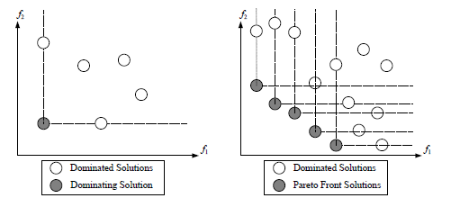
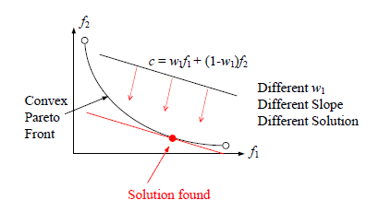
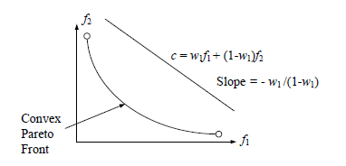
The Main Idea Beneath the Scalarization and Weighted Sum Approach (II)
Figure 1: Pictorial descriptions of domination and the Pareto Front.
Figure 3: Pictorial description of how different solutions can be found by altering the weight in the weighted sum approach for convex Pareto Front.
Figure 2: Pictorial description of the solution via the weighted sum approach convex Pareto Front.

Slide 6
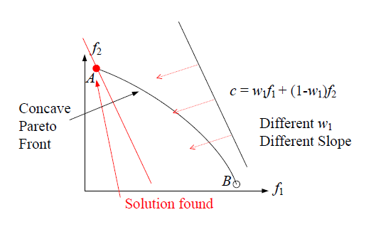
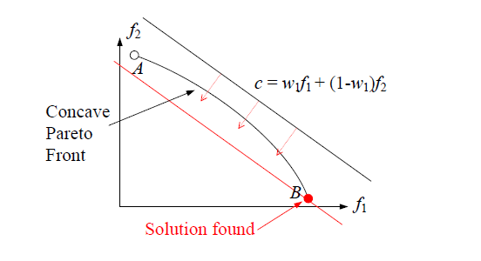
The Main Idea Beneath the Scalarization and Weighted Sum Approach (III)
Figure 4: Pictorial description of the solution via the weighted sum approach for concave Pareto Front (where the point B is found as the solution)
Figure 5: Pictorial description of the solution by altering the weight in the weighted sum approach for concave Pareto Front (where the point A is found as the alternative solution).
Weighted Sum Approach;
is worked well when Pareto Front is in convex form.
fails when Pareto Front is in concave form.
In real problems, it is impossible to know whether the Pareto Front is convex or concave.

Slide 7
Desirability Function- Based Scalarization (I)
The main idea beneath the desirability function
mapping from the domain of real numbers to range set [0,1].
the domain of the each desirability function is one of the objective functions which map values of the relevant objective function to the interval [0, 1].
constructed by depending on desire about minimization of each objective function (i.e., the minimum/maximum tolerable values)
use geometric mean to define the overall desirability value (to be maximized).

Slide 8
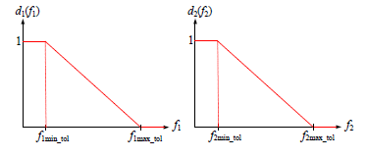
Desirability Function- Based Scalarization (II)
Figure 6: The linear desirability functions constructed for the bi-objective optimization problem.
Pareto Front is extracted
by fixing the parameters f1max_tol and f2max_tol at infinity.
by varying the parameters f1min_tol and f2min_tol systematically.

Slide 9
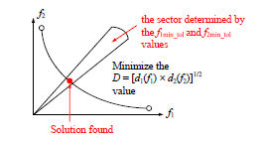
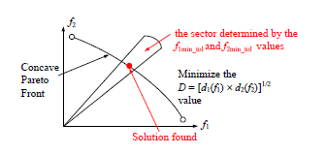
Desirability Function- Based Scalarization (III)
Figure 7: Pictorial description of the solution via the desirability- function based approach for convex Pareto Front
Figure 8: Pictorial description of the solution via the desirability- function based approach for convcave Pareto Front
Desirability Function- Based Scalarization approach
finds solution when Pareto Front is in convex or concave form.

Slide 10
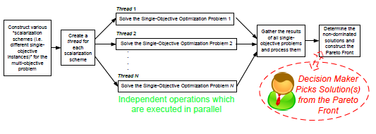
Parallel CUDA Implementation of the Desirability Function- Based Scalarization (I)
Figure 9: Pictorial description of the parallel CUDA implementation of the desirability-function based approach
If the problem is mission planning
Two objectives:
Minimizing the overall mission completion time.
Minimizing the overall mission risk.
The Pareto Front:
plethora of different various alternative mission plans with different overall completion time and risk values.
Regardless of choice the particular picked solution will be non-dominated.

Slide 11
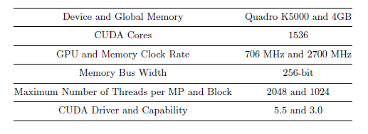
Parallel CUDA Implementation of the Desirability Function- Based Scalarization (II)
In order for verification of the aforementioned claims,
GPGPUs via CUDA framework is used.
Table 1: The environment in which the simulations are run.

Slide 12
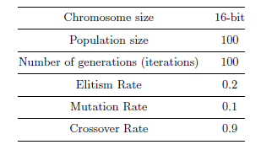
Parallel CUDA Implementation of the Desirability Function- Based Scalarization (III)
An Elitist Genetic Algorithm is implemented.
Table 2: Genetic Algorithm parameter throughout the simulations

Slide 13
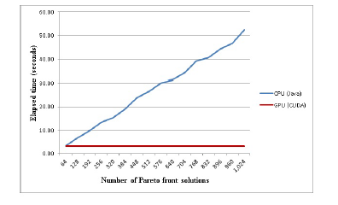
Lessons Learned (I)
Figure 10: Comparison of the sequential Java and the parallel CUDA implementations.
It was seen that
Sequential Java and parallel CUDA implementations find the same solutions but in different elapsed times.
The number of Pareto front increase, the advantage of the parallel CUDA appears dramatically.

Slide 14
Lessons Learned (II)
Throughout the implementation the followings were experienced:
Memory allocations shall be made in advance in a bulk manner.
For random number generation various alternative approaches can be preffered:
To generate each random number at CPU when required and to transfer it to the GPU
To generate all random numbers at the CPU prior to the solution and to transfer them to the GPU
To generate each random number directly at the GPU with no CPU- GPU communication need.
Brute- force editing of the relevant key value in the operating system registry shall be made in order to prevent the operating system from killing the process due to time-out.

Slide 15
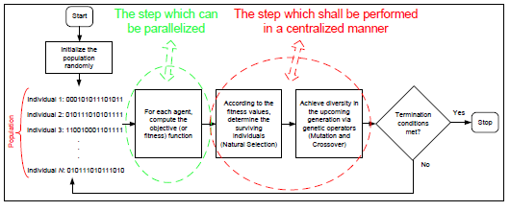
Lessons Learned (III)
Throughout the implementation, the following was observed:
In the current situation, it is possible to achieve up to 16 times faster GPU implementations for the multi-objective problems via careful and intelligent CUDA implementation.
Figure 11: The steps of the Genetic Algorithm with indications of parallelization.

Slide 16
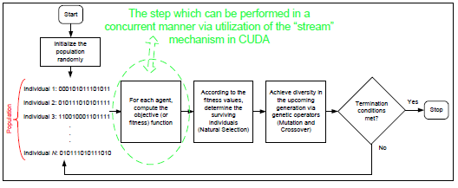
Future Work
Figure 12: The step of the Genetic Algorithm which can be executed concurrently via utilization of the stream mechanism in CUDA.
The aims as a future work
utilization of the stream mechanism in the suitable piece of the algorithm.
taking advantage of the shared memory in the GPGPU.

Slide 17
Acknowledgement
The Turkish Ministry of Science, Industry and Technology (Industrial Thesis San-Tez Programme and HAVELSAN; with Grant Nr. 01568.STZ.2012-2)
The Scientic and Technological Research Council of Turkey – TUBITAK (with Grant Nr. 112E168)
The authors;
O. Tolga Altinoz (TED University Department of Electrical-Electronics Engineering, Ankara, Turkey, tolga.altinoz@tedu.edu.tr)
S. Uckun Emel (HAVELSAN A.S., Ankara, Turkey, semel@havelsan.com.tr)
A. Egemen Yilmaz (Ankara University Department of Electrical-Electronics Engineering, Ankara, Turkey, aeyilmaz@eng.ankara.edu.tr)
Murat Efe (Ankara University Department of Electrical-Electronics Engineering, Ankara, Turkey, efe@eng.ankara.edu.tr)
Tayfur Yaylagul (HAVELSAN A.S., Ankara, Turkey, tyaylagul@havelsan.com.tr)

Slide 18
References
R. Marler, and S. Arora. Transformation methods for multiobjective optimization.Engineering Optimization, 37:551{569, 2009.
R. Marler, and S. Arora. The weighted sum method for multi-objective optimization: new insights. Structure Optimization, 41:853{862, 2010.
S. Saramago, and V. Stefen. Optimization of trajectory planning of robot manipulators taking into account the dynamic of the system. Mechanical Theory, 33:883{894, 1998.
J. Keski, and R. Silvenneinen. Norm methods and partial weighting in multicriteria optimization of structures. International Journal of Numerical Methods, 24:1101{1121, 1981.
H. Trautmann, and J. Mehmen. Preference-based pareto optimization in certain and noisy environments. Engineering Optimization, 41:23{38, 2009.
N. Srinivas, and K. Deb. Multi-Objective function optimization using non-dominated sorting genetic algorithms. Evolutionary Computation, 2:221-248, 1995.
K. Deb, A. Pratap, S. Agarwal, and T. Meyarivan. A fast and elitist multiobjective genetic algorithm: NSGA-II. IEEE Trans Evol Comput., 2:182-197, 2002.
JD. Schaer. Multiple objective optimization with vector evaluated genetic algorithms. In Proceedings of the international conference on genetic algorithm and their applications, 1985.
RS. Burachik, CY. Kaya, and MM. Rizvi. A new scalarization technique to approximate Pareto fronts of problems with disconnected feasible sets. Journal of Optimization Theory and Applications, appeared online, June 2013, DOI 10.1007/s10957-013-0346-0.
OT. Altinoz, AE. Yilmaz and G. Ciuprina. A Multiobjective Optimization Approach via Systematical Modication of the Desirability Function Shapes. In 8th International Symposium on Advanced Topics in Electrical Engineering, pages 23{25, Bucharest, Romania, 2013.
G. Derringer, and R. Suich. Simultaneous optimization of several response variables. Journal of Quality Technology, 12:214{219, 1980.

Slide 19
Thank You for Listening

